Slide 1
ASIS Ottawa Chapter 140 2022 AGM
November 23, 2022
Notes:
Welcome Guests, Speakers, Sponsors
Lina Tsakiris, Victor Munro
ADSS, Attain, Feenics, Genetec, Rhea, Securitas, Shopify, Stantec, 360 ASC
Logistics
Dan

Slide 2
Chapter Sponsors
The following companies support the ASIS Ottawa chapter. Thanks for your support!
2
Notes:
Welcome Guests, Speakers, Sponsors
Lina Tsakiris, Victor Munro
ADSS, Attain, Feenics, Genetec, Rhea, Securitas, Shopify, Stantec, 360 ASC
Logistics
Dan

Slide 3
Opening remarks Year in review Recognition and awards Keynote presentation Student Scholarship Elections
3
Notes:
Agenda
Dan

Slide 4
Opening remarks from the Chapter Chair
Dan Corriveau, CPP, PSP
4
Notes:
“A banker fell overboard from a friend’s sailboat. The friend grabbed a life preserver, held it up, not knowing if the banker could swim, and shouted, ‘Can you float alone?’ ‘Obviously,’ the banker replied, ‘but this is a heck of a time to talk business.”
Dan

Slide 5
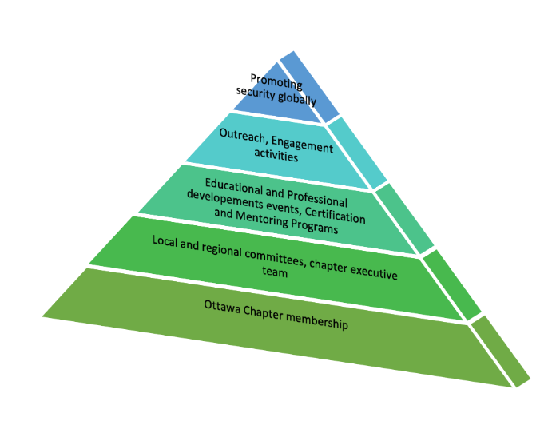
2022-23 STRATEGIC PLAN
Setting up a solid foundation for the local chapter
Finding additional resources (recruiting new volunteers, joint chapter efforts, new committees)
Staying visible and relevant
Conducting meaningful events and more sustainable actions
Developing a succession plan
5
Notes:
The goal for 2022 and 2023 was to strengthen the foundation for the Ottawa Chapter
Our vision 2022/23 was to focus on:
The development of additional committees focusing on Women in Security, Education and Certification as a starting point
Collaboration and benchmarking with other chapters across Canada and ASIS Canada
And leveraging additional resources through ASIS International
Creating sustainable initiatives focusing on education and certification
Staying visible and relevant by connecting with our members and the security community to gauge interest get valuable feedback
Lastly in developing a stronger foundation for the chapter this sets us up for success when it comes to succession planning as the goal
CORE VALUES
Essential to ASIS International’s success globally are common, core values that will bind our organization leadership together. Our core values include a commitment to:
Creating a welcoming environment and community for all security management practitioners and related stakeholders.
Creating a community that collectively addresses profession-related challenges in a way that respects global, regional, and local practices.
Transparency in operation and decision-making, including selection of volunteer leaders and decision-making efforts of leadership bodies.
Encouraging diversity in organization membership and Individual characteristics.
Demonstrating respect and courtesy for all security management practitioners and related stakeholders.
Dan

Slide 6
2023 Objectives and Strategic Plan Continued
Member engagement
Volunteers
Planning sessions
Education and Certification
Collaboration
6
Notes:
We have made great progress this year, and aim to do more to further the chapter next year.
We will start with member engagement, your feedback is valuable to us. This enables us to have the greatest impact and bring value to our community. Keep an eye out for the pulse survey in the coming months.
We are always looking for volunteers, this is a minimal commitment. A few meetings a year, a few hours hear and there, you do what you can.
Planning sessions, we will host a planning session, open to all committee members and will share the results back with our members.
Continued focus on education and certification. This stems member feedback, so far in the past two years we have ran a CPP and PSP study group based on your feedback.
Continued collaboration with other chapters to benchmark, ASIS Canada and International to align and seek additional resources, and industry professional organizations such as CANASA, ACOPS to to name a few.
Dan

Slide 7
Overview of 2022 activities
Raphael Duguay, CPP, PSP
7
Notes:
Raphael

Slide 8
January Pulse survey
Two Townhall Meetings
Webinar and Panel on Threat and Risk Assessment
Webinar and Panel of Aviation Threats Posed from Commercial Drones
Summer Social
Annual Golf Tournament
Campus Security Event
Over 10 committee meetings and roundtable discussions
Certification information session
PSP study group 2022-2023
Outreach presentations with ACOPS, La Cité, CANASA
Participation in Security Center of Excellent (SCoE) Working Group on GC Security Professionalization
8
Notes:
The annual Golf Tournament saw over 100 golfers
Raphael

Slide 9
Certification achievements
New Certification Committee
Terms of reference
New Chapter library
CPP study guides
PSP study guides (new)
- Certification survey
Special certification newsletter (new)
PSP study group 2022-2023 (ongoing)
Certification coaches (new)
Members of the ASIS Ottawa Certification Committee
Shaun J. Brabazon, M.Ed., CPP, Chair
Raphaël Duguay, PSP, CPP, ASIS Ottawa certification liaison
Al McDougall, CISSP CPP PSP, member
Jason Renaud, CPP, member
Jacques Gagne, CPP, member
Eduardo De Diego, PSP, member
Andre St-Pierre, CPP, member
Allan Chabot, CPP, member
David A. Black CPP, member, Volunteering mission in Ukraine
Gaby Khoury, CPP, member
9
Notes:
Raphael

Slide 10
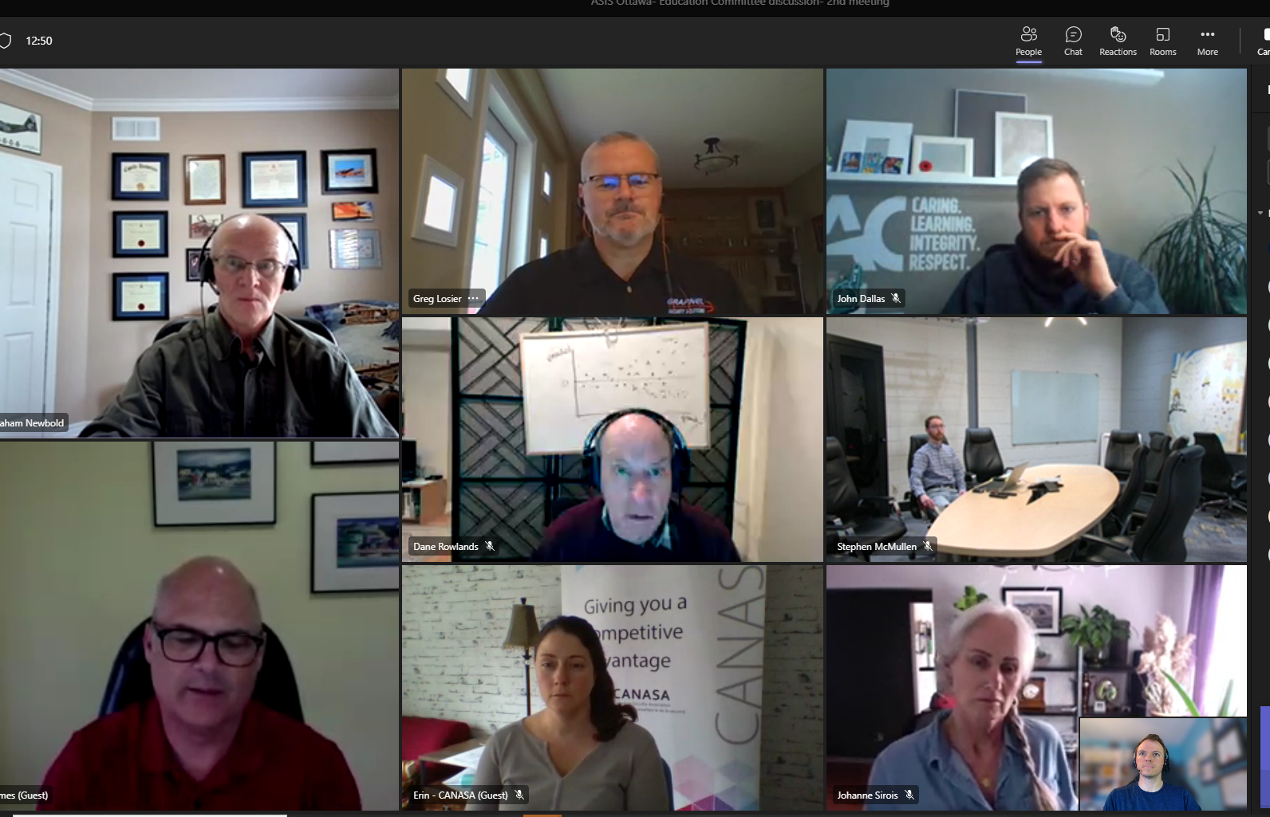
Building bridges
Members of the ASIS Ottawa Education Committee
G.P. Losier, CPP, ABCP Chair
Raphaël Duguay, PSP, CPP, Co-Chair
Dane Rowlands Member
Alex Wilner Member
John Dallas Member
Maj (Ret’d) Graham Newbold, PhD Member
James Clemens Member
Johanne Sirois Member
Costanza Musu Member
Juliana Rapper Member
Phil Gurski Member
Sophie Jenkins Member
New Education Committee
Terms of reference
Outreach with colleges and universities
Communication with student community
Participation in the Security program committee (Lacité)
New COOP/internship page on website
Student Scholarship Competition
Essay review committee
10
Notes:
Raphael

Slide 11
Women in Security
Members of the ASIS Ottawa WIS Committee
Nicole Ouellet Chair
Jenna Rolfe Member
Juliana Rapper Member
New Women in Security Committee
Terms of reference
Outreach within our community
Inspire Career Growth, Professional Confidence, and Deeper Global Connections
Social Events
Education sessions
Notes:
Raphael

Slide 12
Next Gen
Members of the ASIS Ottawa Next Gen Committee
Luis Morales Martinez Chair
Kyle Burrows Member
Cory Oliveira, CPP, PSP Member
Aaron Ramhit Member
Rebranding of Young Professionals Committee as Next Gen
Outreach within our community
Inspire Career Growth, Professional Confidence, and Deeper Global Connections
Social Events
Student Scholarship Competition
Education sessions
Notes:
Raphael

Slide 13
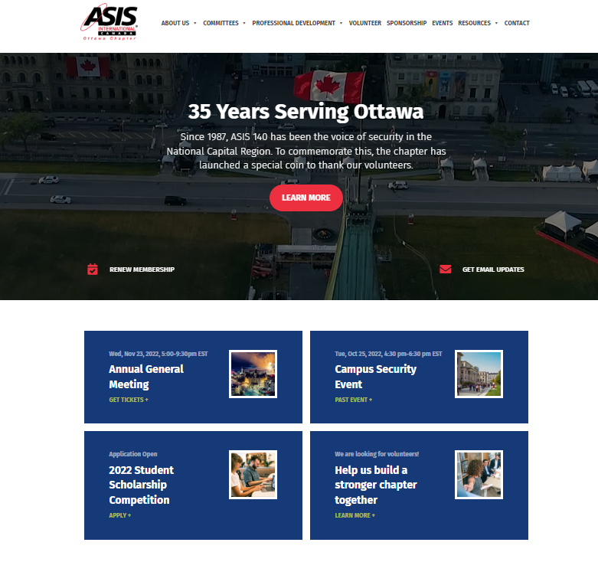
Communication initiatives
Website upgrades with more content and programs
Mentoring
Job opportunities
Past webinars
Certifications
Chapter library
Resources
New LinkedIn page
Quarterly newsletters
Special thanks to all contributors
13
Notes:
Raphael

Slide 14
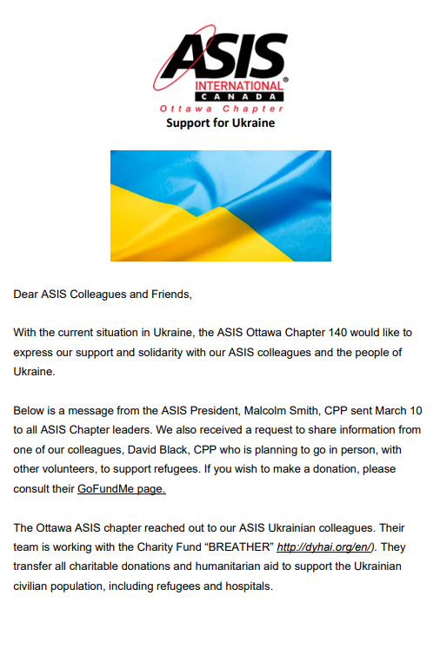
Other highlights
Our voice and our support and solidarity with our ASIS colleagues and the people of Ukraine.
Collaboration with CANASA
Collaboration with and building relationships with other organizations*
14
Notes:
Raphael

Slide 15
FINANCE OVERVIEW
Mathieu Leduc, CPP, PSP
15
Notes:
Mathieu

Slide 16
Chapter Financial Summary
Balance as of January 1st, 2022 | $6,339.02
Balance as of November 23nd, 2022 | $12,909.49
Projected balance – December 31st, 2022 | $2,400.00
Sponsors 2022 | 9
Projected Sponsorship Availability | 7
Notes:
Mathieu

Slide 17
Recognitions and Awards
Mark Bottomley, CPP, PSP
17
Notes:
Mark

Slide 18
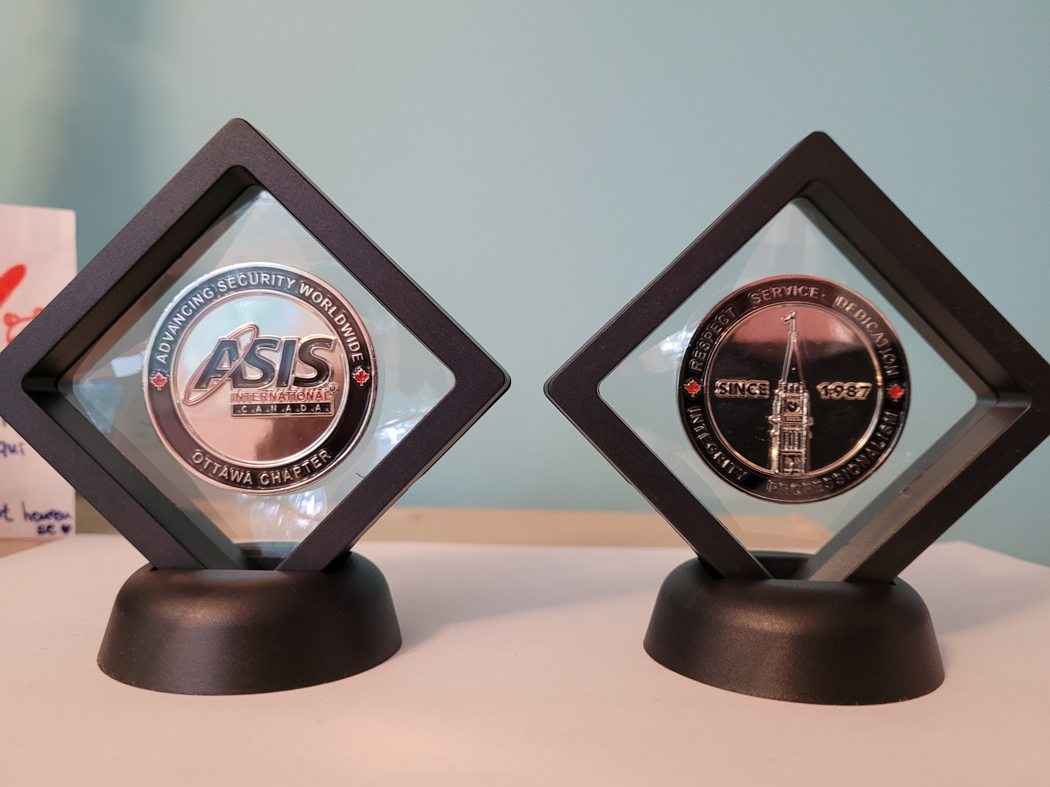
2022 ASIS Ottawa challenge coin recipients
An honorary gift to lecturers, volunteers, speakers, executive team members, newly certified members and members that have made important contributions to the community
James Clemens
Costanza Musu
Maj (Ret’d) Graham Newbold, PhD
Johanne Sirois
Sophie Jenkins
Juliana Rapper
Jake Sheridan
Chris Woods
Hi Nguyen
Michael Beaudette, MSC, CD
William Edwards
Shawn Goudge
Terri Govang, CPP
Nicole Ouellette, CPP
Eduardo De Diego, PSP
Andre St-Pierre, CPP
Jason Renaud, CPP
Shaun Brabazon, M.Ed., CPP
Al Macdougal, CISSP, CPP, PSP
Gaby Khoury, CPP
Aaron Ramhit
Jenna Rolfe
John Dallas
Alex Wilner
Greg Losier, CPP, ABCP
Dane Rowlands
Phil Gurski
18
Notes:
Mark

Slide 19
2020-22 ASIS Ottawa APP Certifications
Kelly Wong, APP
Anthony Terzo, APP
Francis Moliere, APP
Trevor Anders, APP
Olabiyidemi Simoyan, APP
19
Notes:
Mark

Slide 20
2020-22 ASIS Ottawa PSP Certifications
Michael Bambrick, PSP
Daniel Labonte, PSP
Paul Nieman, PSP
Scott Knox, PSP
Jeff Hennessy, PSP
Stephen Kinnaird, PSP
John Evans, PSP
David Carnegie, PSP
Derek Jodrey, PSP
Lee Morton, PSP
20
Notes:
Mark

Slide 21
2020-22 ASIS Ottawa CPP Certifications
Nicole Ouellet, CPP
Raphael Duguay, CPP, PSP
Christopher Moy, CPP
Mathieu Leduc, CPP, PSP
Paul Tremblay, CPP
Derek Beer, CPP
Almero Retief, CPP
Dan Corriveau, CPP, PSP
Gregory Losier, CPP
Jess Solinas, CPP
Kehinde Oni, CPP
Shaun Brabazon, CPP
Victor Mitev, CPP
Nicholas Saucier, CPP
Scott Hill, CPP, PSP
Clayton Foster, CPP
21
Notes:
Mark

Slide 22
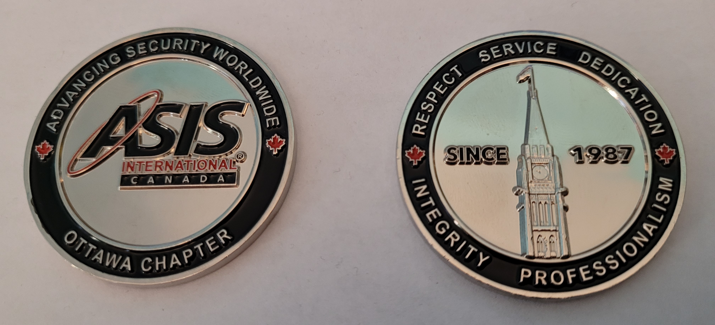
2020-22 Ottawa Certified members
Challenge coin distribution is coming, more to follow
22
Notes:
Mark

Slide 23
Keynote Presentation Insider Risk Management, Value and Victories
Victor Munro and Lina Tsakiris, CPP, ITPM
23
Notes:
Dan

Slide 24
2022 Student Scholarship Competition
24
Notes:
Mark

Slide 25
Criteria: Research, argument, analysis, clarity and format
Asia | Aziz | Master of Public & International Affairs University of Ottawa | What are the principal ways in which global changes are affecting Canada?
Maciej | Paduch | Engineering Physics Carleton University | Effects of evolving technology, automation and artificial intelligence in the Security Industry
Aidan | Scharf | Bachelor of Public Safety at Algonquin College | Onward and Upward: The Future of Business Continuity Planning
Laurie | Martel | Conflict Studies and Human Rights University of Ottawa | Analyse des enjeux de sécurité à l’ère post-Guerre Froide
Notes:
Mark

Slide 26
Congratulations to Aidan Scharf, Bachelor of Public Safety at Algonquin College Onward and Upward: The Future of Business Continuity Planning
Notes:
Mark

Slide 27
Elections
Elections Chair
27
Notes:
Dan

Slide 28
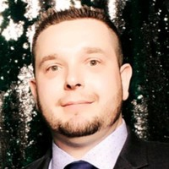
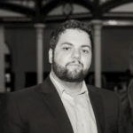
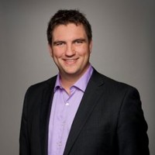
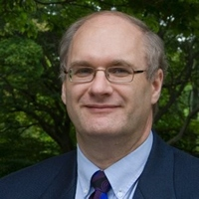
2023 Executive Nominations
Chair
Vice Chair
Treasurer
Secretary
Dan Corriveau CPP, PSP
Senior Program Manager
Telus Business
Cory Oliveira CPP, PSP
Top 10 Under 40 2021
Former Shopify
Mathieu Leduc CPP, PSP
VP
Rhea Inc.
Mark Bottomley CPP, PSP
Senior Project Manager
ADGA Consultants Group Inc.
28
Notes:
Dan

Slide 29
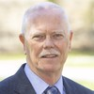
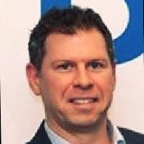
2023 Committee Nominations
Allan T. Burns, PCI, CMM III
Sergeant at Arms
Law Enforcement Liaison
Allan Chabot CPP, CSPM
Certification Committee
Thank you for stepping up to the challenge!
29
Notes:
Dan

Slide 30
Thank you!
30

